Slide 1
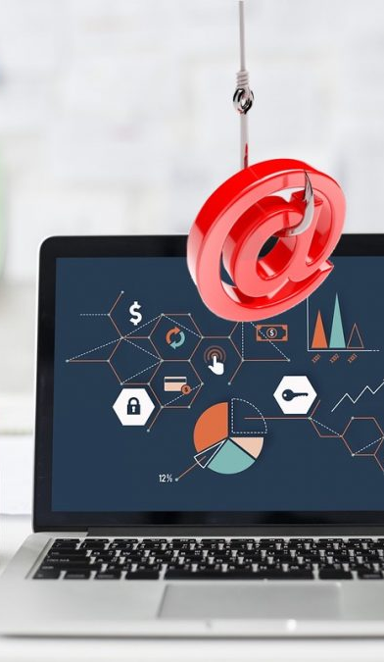
Phishing Attacks and how we can protect ourselves?

Slide 2
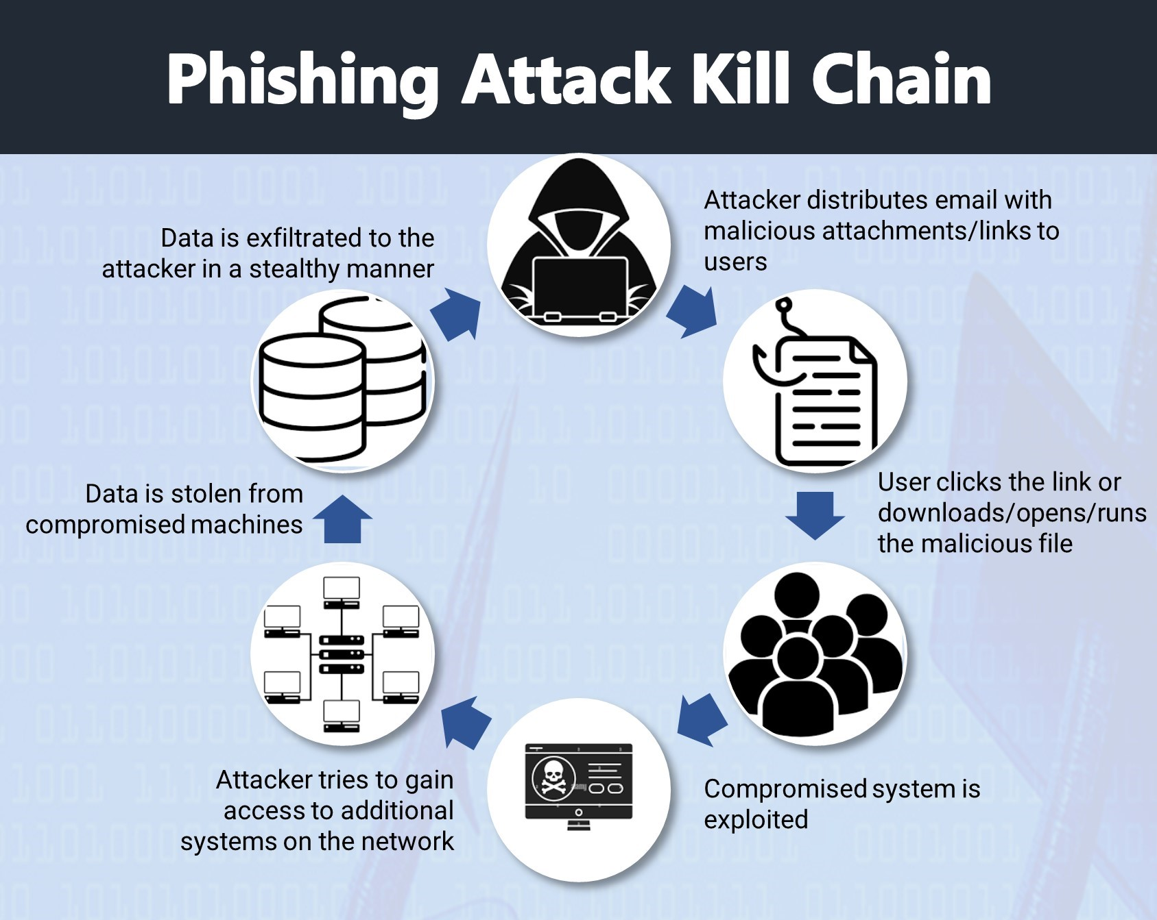
What is Phishing?
Phishing attacks are the practice of sending fraudulent communications that appear to come from a reputable source.
Modes of Phishing Attacks:-
Emails
Sms
Calls

Slide 3

Why Do We Get Fake Emails?
People are the weakest security link in most business processes
We can secure our networks, computers, systems, and internet access to make it more difficult to compromise information.
People making decisions on emails that request action is a manual process that cannot always be controlled
It’s easier for hackers to use people to gather information and build schemes to get what they want
Over reliance on tools. We have the tool Mimecast for blocking malicious mails, but no tool is 100 % accurate as new attacks signatures are constantly being created.

Slide 4


Concept behind Phishing
Social Engineering principles allow attackers to manipulate a victim’s decision-making. The driving factors of this deception are three-fold:
Trust: By posing as legitimate individuals and organizations, cybercriminals lower their target’s skepticism.
Context: Using a situation that could be relevant to targets allows an attacker to build an effective disguise. The message feels personalized, which helps it override any suspicion that it might be spam.
Emotion: By heightening a target’s emotions, attackers can override their target’s critical thinking and spur them into rapid action.

Slide 5
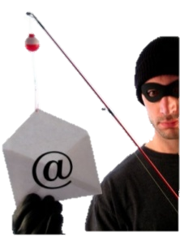
How to Recognize Fake Emails
Legitimate companies do not send email requesting sensitive information
Don’t trust the name in the from field of an email
If it looks suspicious do not open the email
Hover over links to see what address the link takes you
Open a new browser window and type the website address directly into the browser rather than clicking on the link
Most companies use secure web addresses identified by using https:// in the address bar instead of just http://

Slide 6
How to Recognize Fake Emails
Obvious grammar or spelling errors
Strange message structures
Generic greeting
Urgent language
Generic closing
When in doubt, click the “Reply All” button
This may reveal the true e-mail address
Don’t click on email attachments
Review the email signature
Lack of details on contacting the company

Slide 7
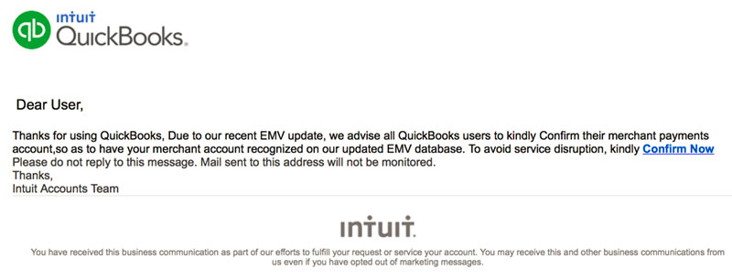
Alarmist Email Social Engineering
Do this or else
Criminals try to create a sense of urgency so you’ll respond without thinking

Slide 8
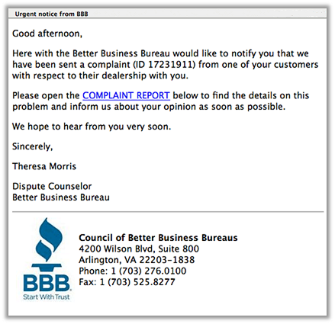
Grammar/Spelling Issues
Often times phishing messages have typos, grammatical errors, or extra characters

Slide 9
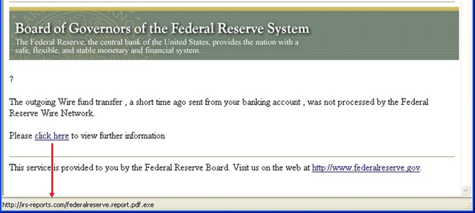
Examine Hyperlinks
Hover over links
Type into a browser to avoid subtle changes

Slide 10
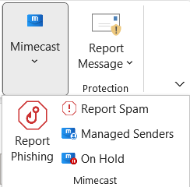
What to Do With These Emails
DO NOT CLICK ON UNKNOWN LINKS OR ATTACHMENTS
Emails that come from outside tavant will have a banner at the top showing that it is an external mail.
If you are confident that it is a Phishing mail, then mark it as so in the Mimecast extension for Outlook. Please install it if you don’t have it.
If not sure about the email’s origin then contact the Inofsec Team to let them know about the email and they will let you know what to do with it.

Slide 11

Response to Clicking on a Fake Email
If you think you may have clicked on an email you shouldn’t have
Call the IT department to let them know before it is too late to fix.
Do not click on other emails until the IT Department has cleared you to do so
Always take precaution but if there is a mistake, always make sure you acknowledge it as time is of the essence. Sooner the IT team knows, the better it is for addressing the issue.

Slide 12


Fake Email Risk
It only takes one compromise to get information
ONE PERSON–ONE MOMENT–ONE OPPORTUNITY
TODAY, ARE YOU GOING TO BE THAT ONE?

